Slide 1
What is a Database File System
Contents
Definition
Explanation using structures

Slide 2
A Database File System
It is a feature provided to us by Oracle. It basically helps us access and manage files stored in the Database.
The Database File System(DBFS) is placed on top of the files and directories that are stored in a database table.

Slide 3
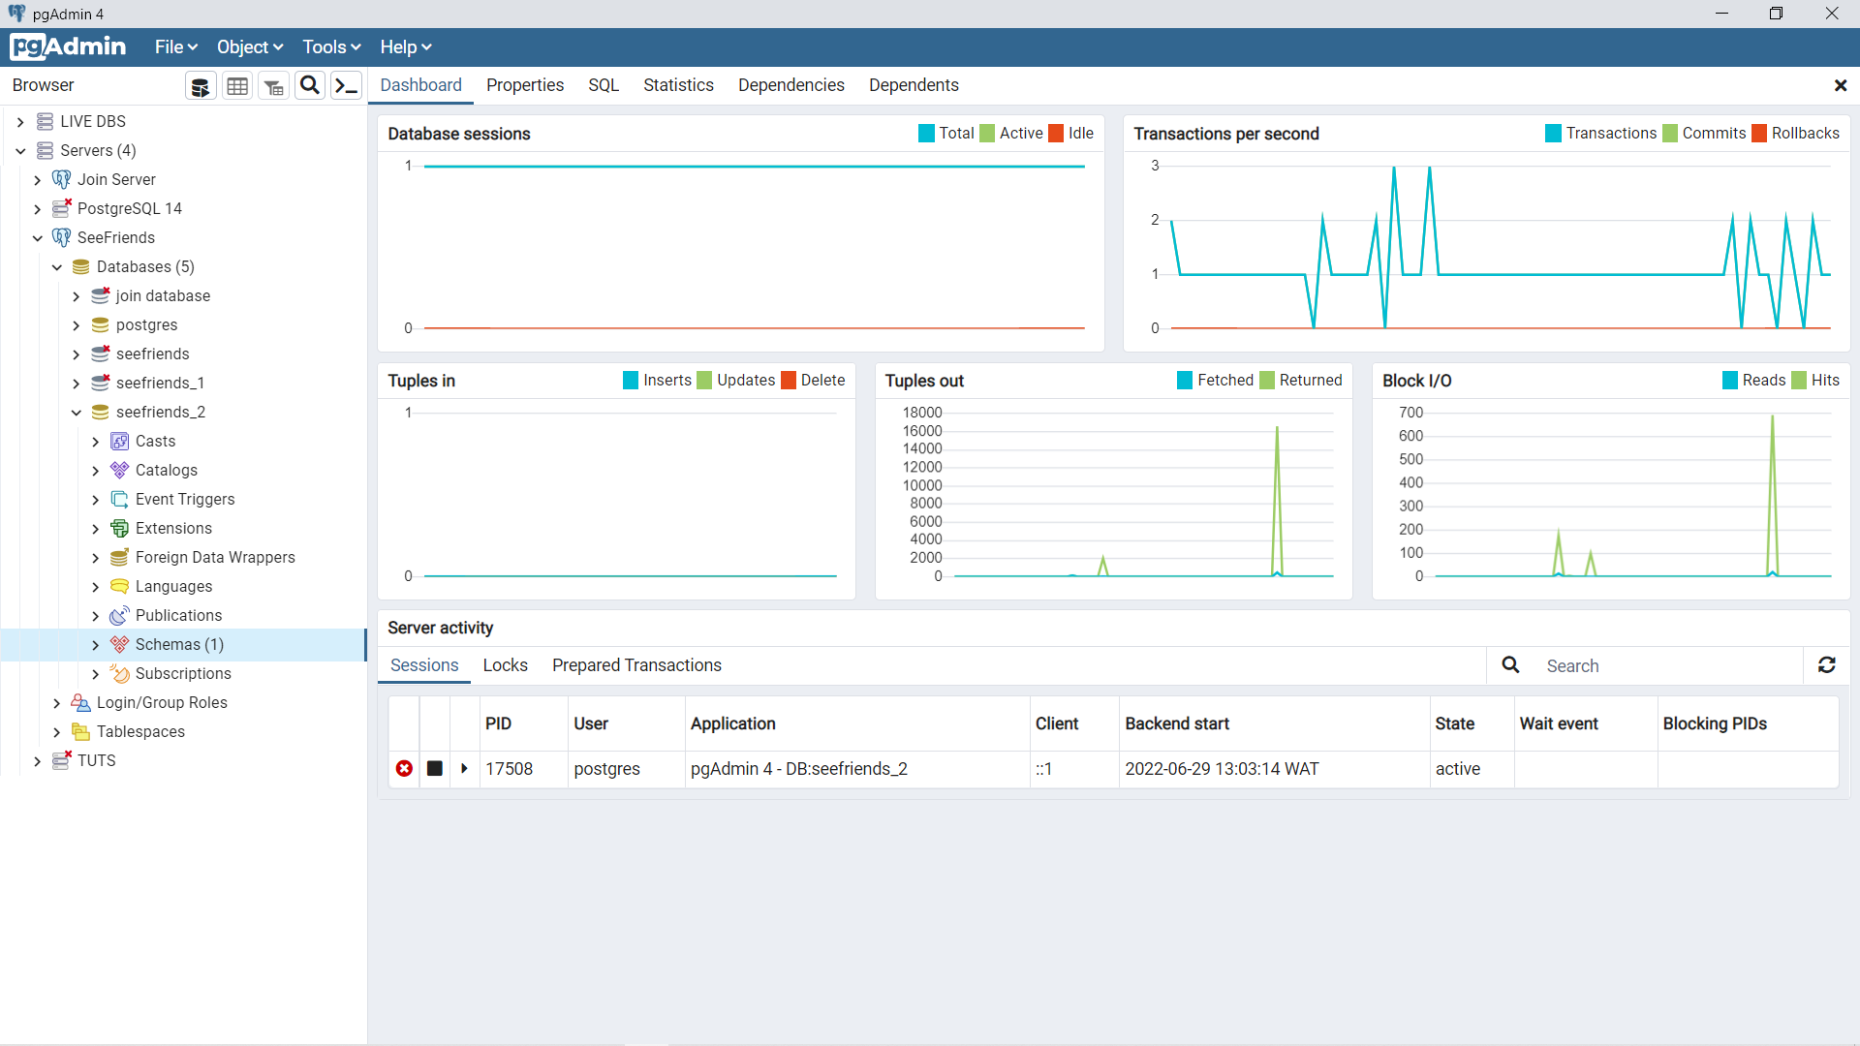
The Structure of A Database
The below diagrams show database structure of an application.
Inside our database > schemas: is where we can find our tables directory that holds all the tables to this database seefriends_2.

Slide 4
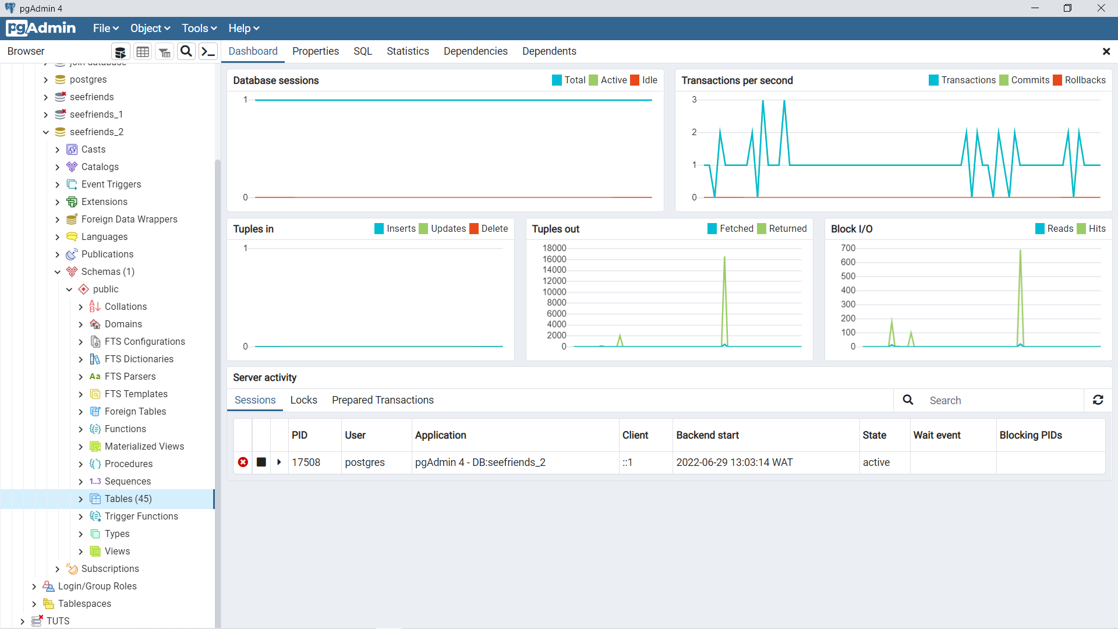
Inside our Schemas > Public: we see several related objects amongst which we have our database tables directory populated with over 40 tables

Slide 5
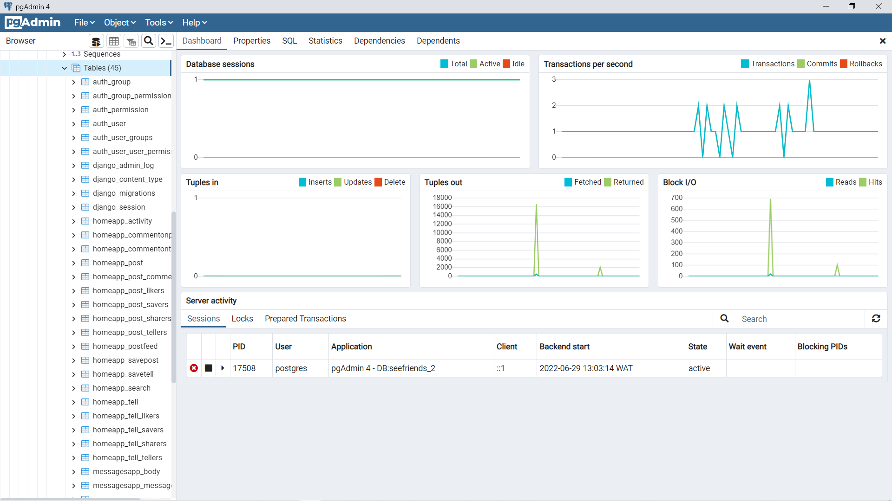
Now inside our database directory, we have several database tables holding the data to several important parts of our application.

Slide 6
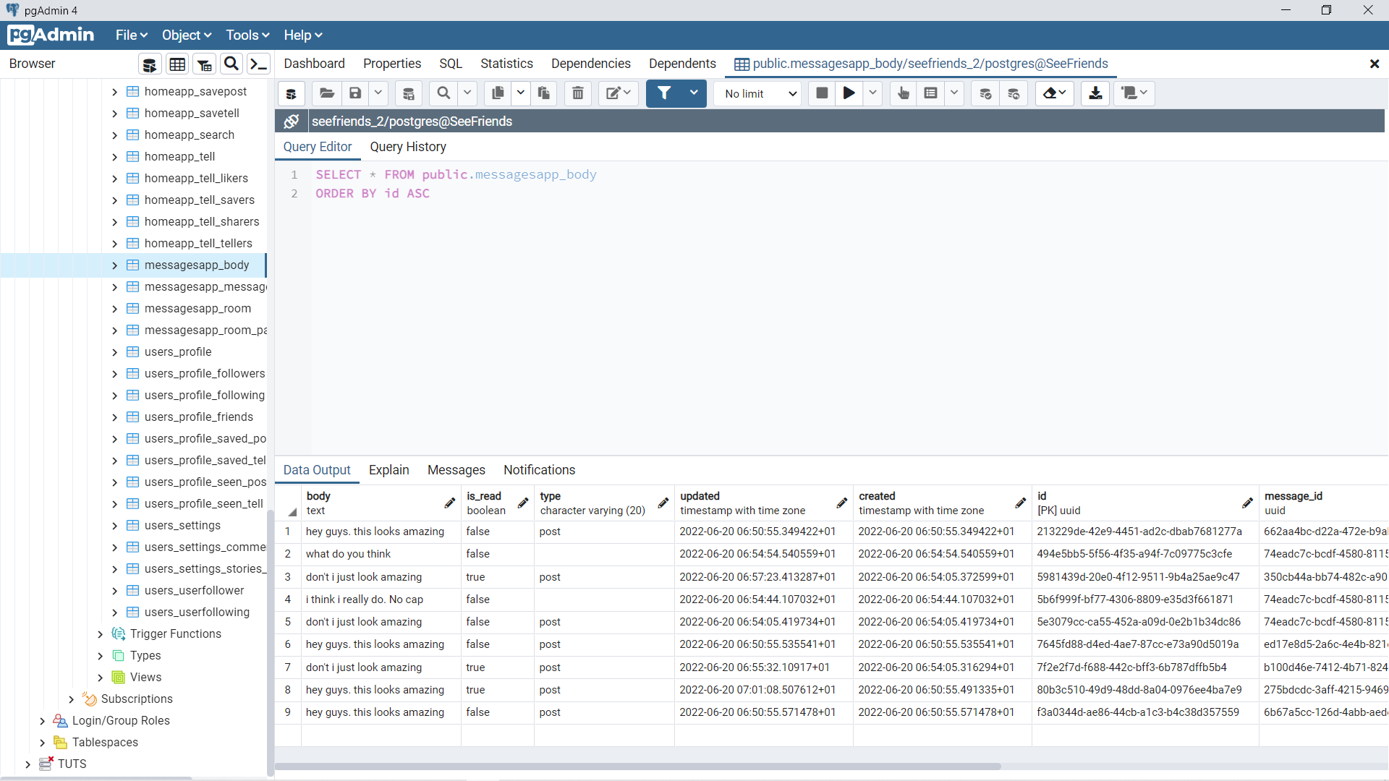
If we open one of the database tables we would get access to some pretty confidential data 😑.

Slide 7

The field we see below can be used to directly manage the contents of the database table we see. But you would have to know some SQL to do that.

Slide 8
With the above structures shown. Using the pgadmin application that uses a DBFS we can access our data stored in our database table and also manage those data.
Made by
Chukwu Daniel Nonso
BHU/20/O4/05/0010
COMPUTER SCIENCE
Thank you

